Slide 1

Analysis & prediction of Tunisair airline delay
By AirorPrediction
Members :Simon,Aylin,Lida

Slide 2
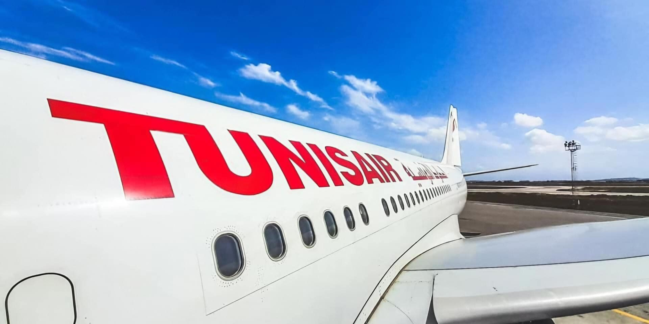
Hypotheses
1-Flights departing from certain airports experience longer delays than others.
2-Flights scheduled for late evening or night departures have a higher probability of delay.
3-Delays are higher during peak travel seasons (summer, holidays)

Slide 3
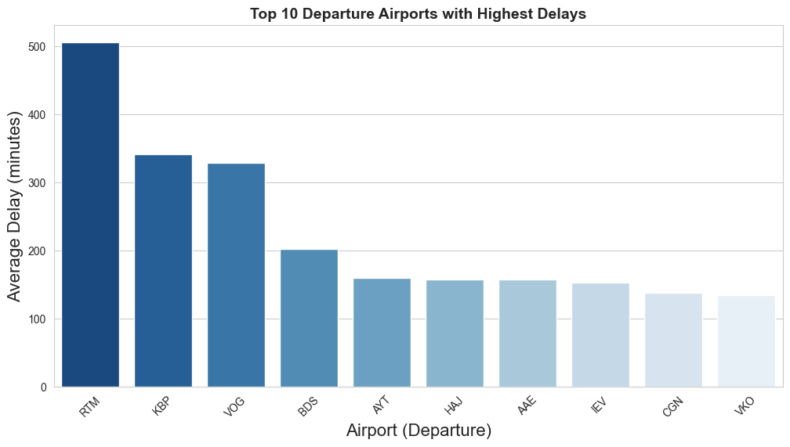
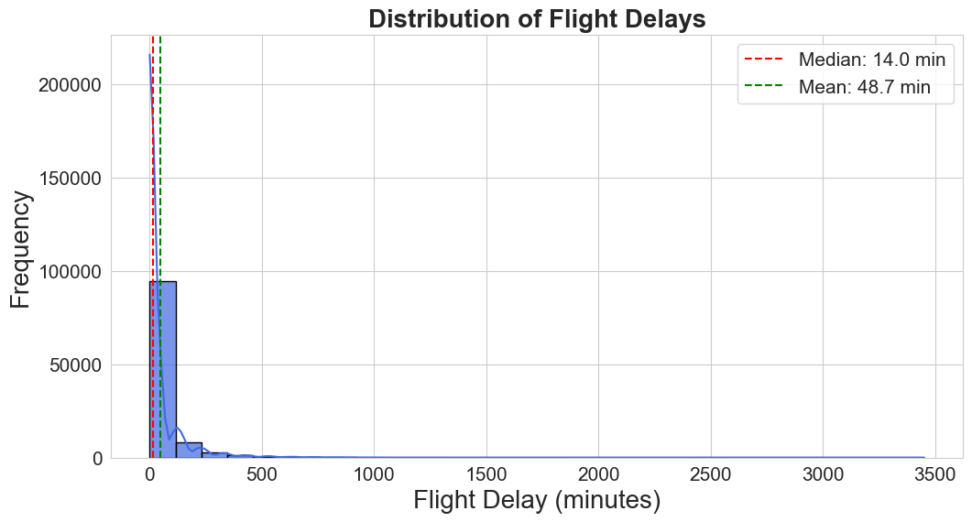
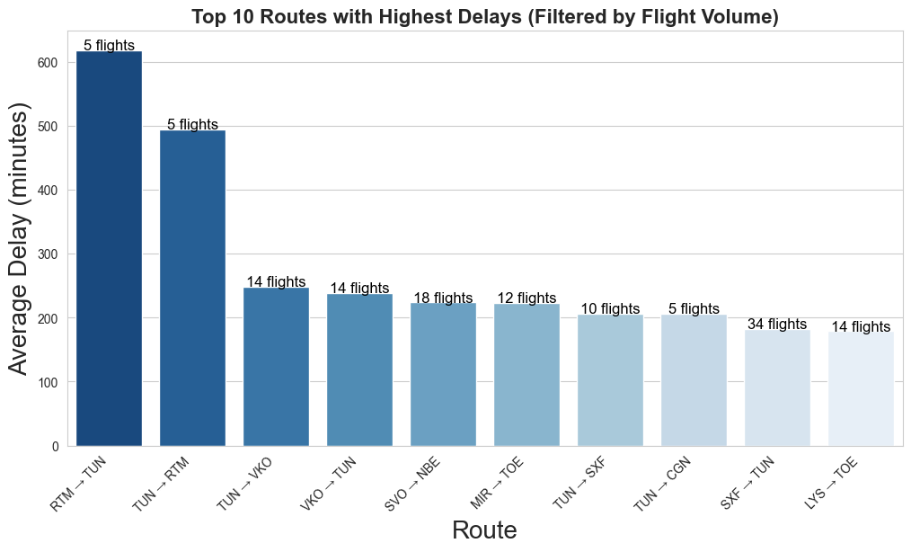
Key insights from data exploration
Most flights have small delays, but a few flights experience very high delays (outliers)
Many flights were on time or experienced no delays

Slide 4
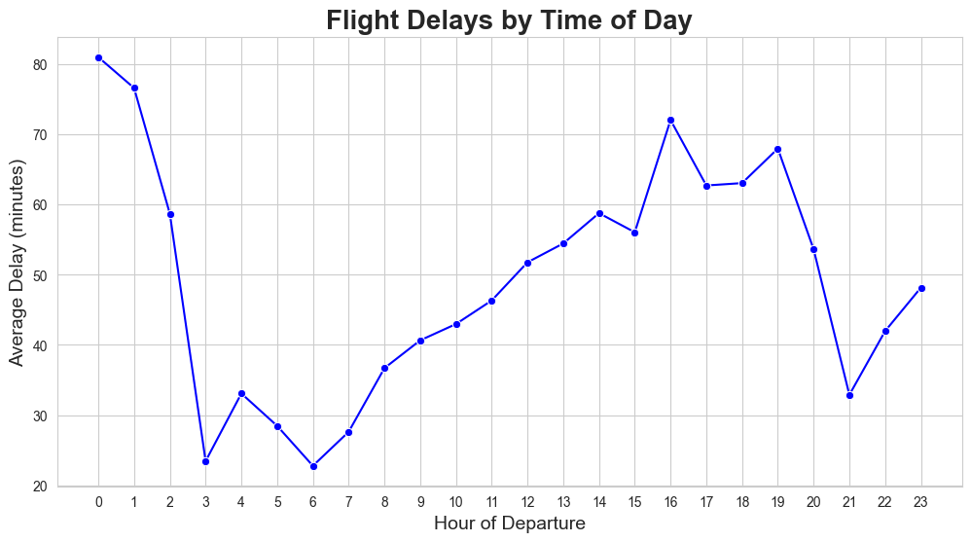
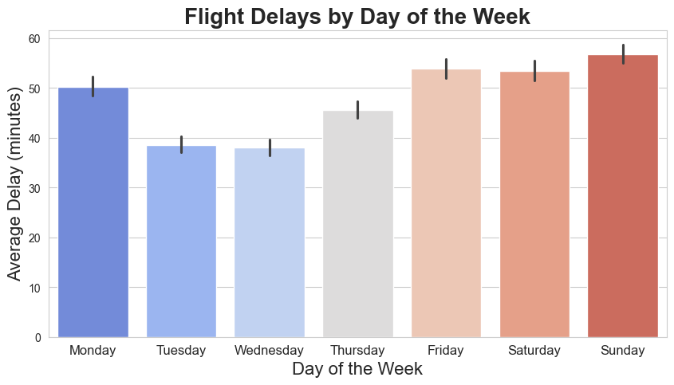
Early morning flights often have fewer delays because they start fresh. (This help passengers choose better flight timings and airlines manage schedules better.)

Slide 5
Building our model
A few words about the data used for modelling
Data from 2016 to 2018
Very complete data – no missing values
What do we want to predict
We want to predict the delay of the flights
Flight status is assigned after flight
cannot be used for predictions
Has not been considered as a prediction target so far
Besides, flights with following statuses were removed from the data set:
RTR – returned to origin
DEL – flight cancelled
SCH – flight scheduled but not finished at the time data was extracted

Slide 6
Building our model
What parameters does our model consider?
Departure airport
Arrival airport
Flight date and time:
Month
Week day
Time of the day
Planned flight duration
What parameters does our model not consider?
Flight number
Aircraft number

Slide 7
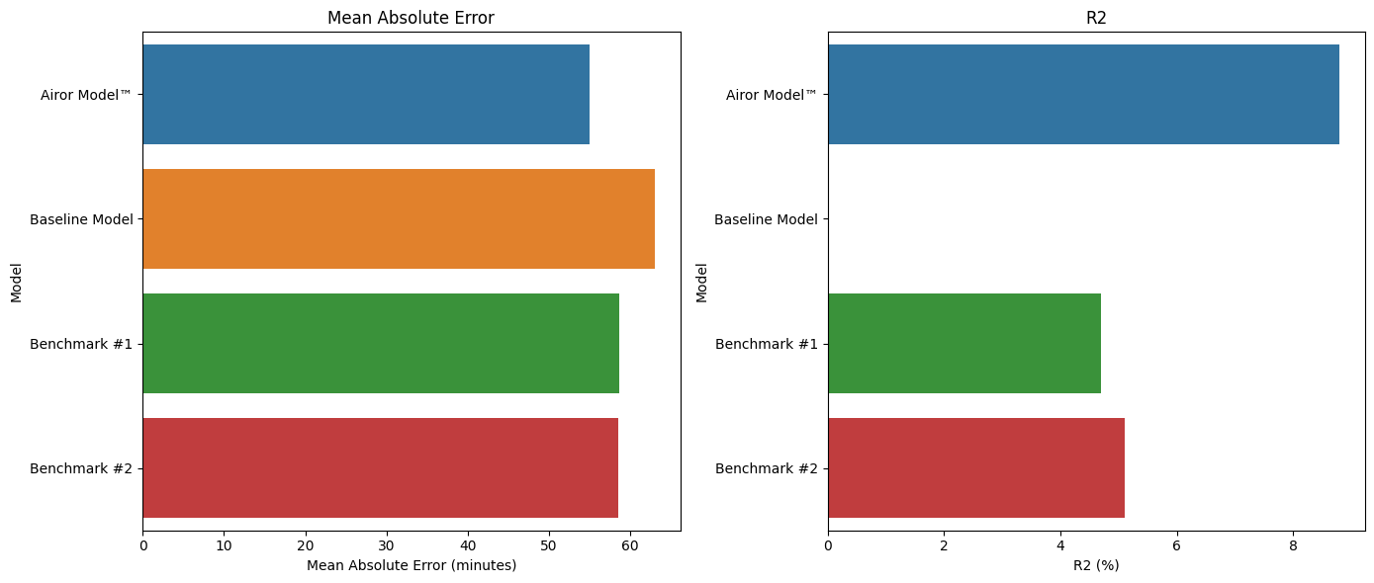
Building our model
Model | Airor Model™ (Categorical Boosting) | Baseline Model (Mean value) | Benchmark #1 (Linear Regression) | Benchmark #2 (Random Forest)
Mean Absolute Error (on test set) (in minutes) | 55 | 63 | 58.7 | 58.6
R2 (on test set) | 8.8% | 0% | 4.7% | 5.1%

Slide 8
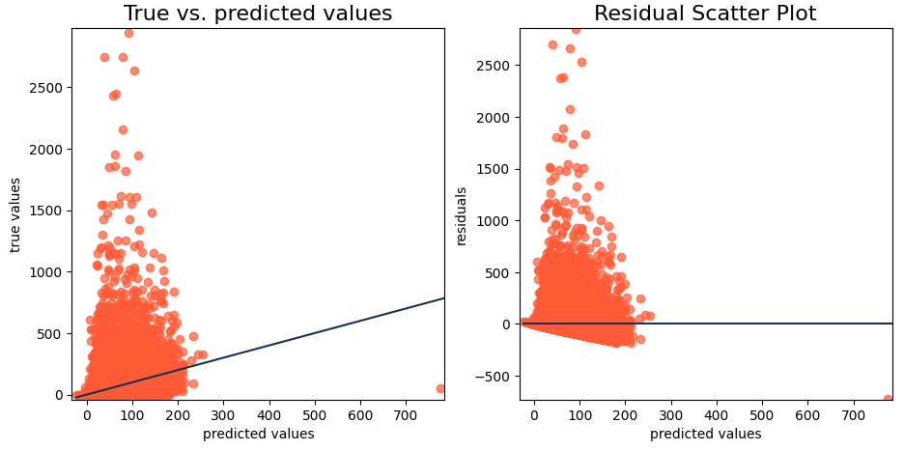
Airor Model™: Evaluation
Mean absolute error: 55.26
R2 coefficient: 0.088
Possible reasons for high error
(e.g., unexpected weather,
industrial actions (strikes))

Slide 9
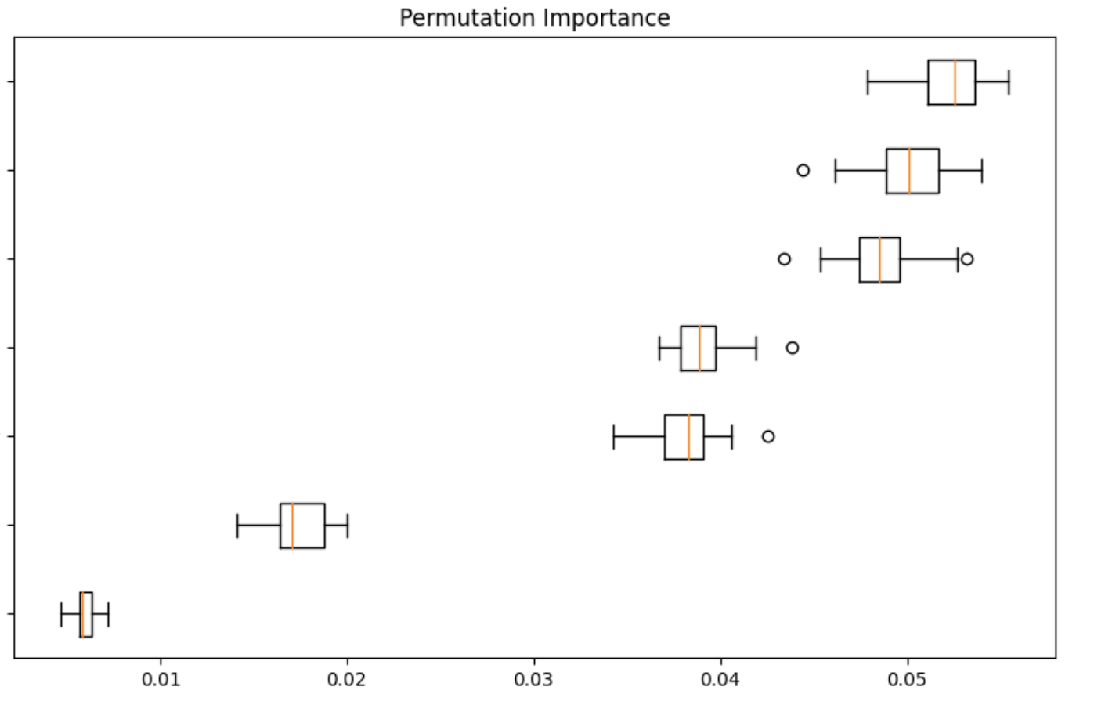
Airor Model™: Important factors
Departure_Airport
Departure_Time
Departure_Month
Arrival_Airport
Flight_Year
Departure_Weekday
Flight_Duration

Slide 10
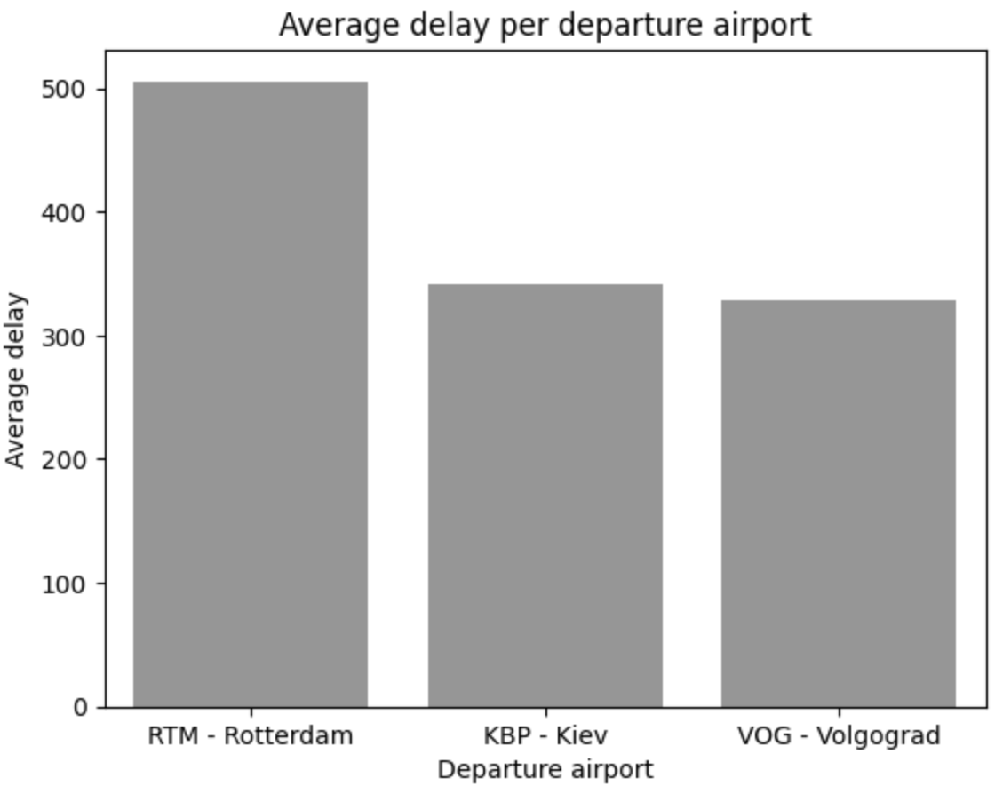
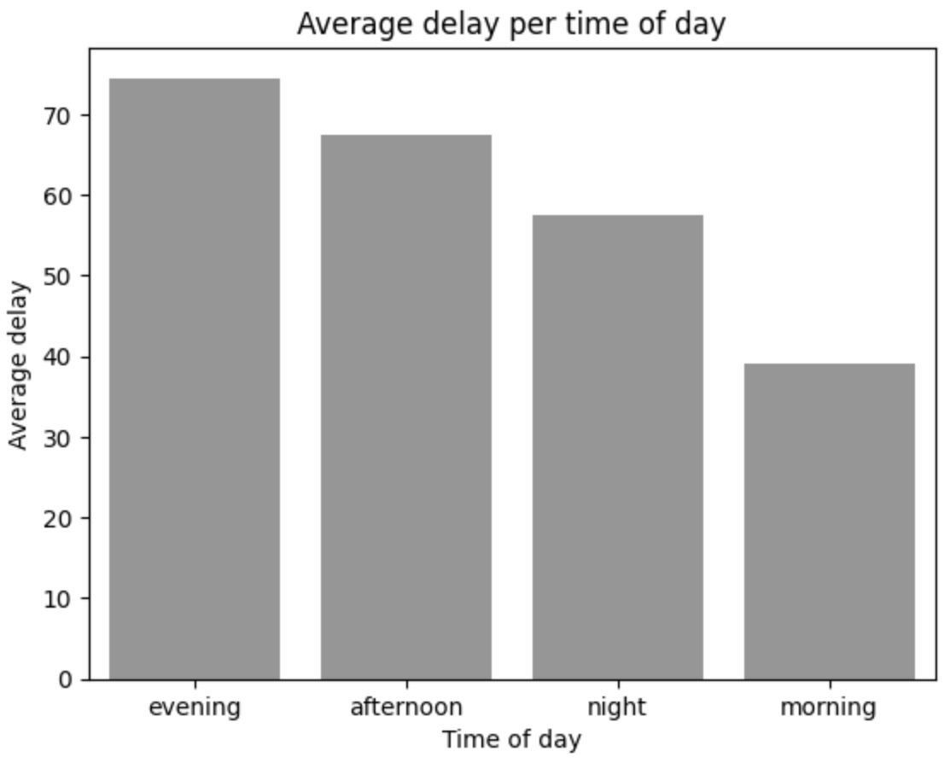
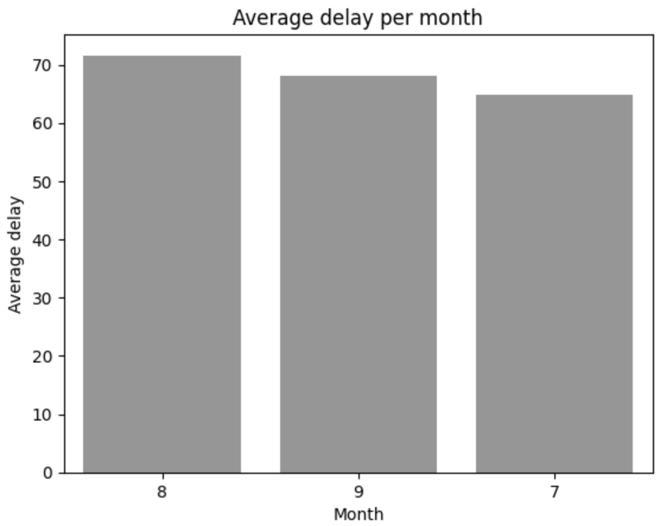
Airor Model™: Important factors

Slide 11
Conclusions and Outlook
Top three factors influencing the delay:
Departure airport
Departure time
Departure month
Next steps:
- Improve model predictions by
considering number of flights per day and aircraft, aircraft type, domestic and international flights
including weather forecast
optimizing model parameters
- Predict status of the flight

Slide 12
Thank you!
Airor Prediction

